Slide 1
Market Structure

Slide 2
Industry
Industry (market) – a collection of firms, each of which is supplying products that have some degree of substitutability, to the same potential buyers
Common buyers for sellers
Common sellers for buyers
Relatively homogeneous product

Slide 3
Market Structure
Market Structure – those characteristics of the market that significantly affect the behavior and interaction of buyers and sellers
A competitive environment in which buyers and sellers of the product operate.
number and size of sellers and buyers
type of the product
conditions of entry and exit
transparency of information

Slide 4
Market Structure
Perfect
Competition
Pure Monopoly
More competitive (fewer imperfections)
Less competitive (greater degree of imperfection)
Notes:
4

Slide 5
Market Structure
Pure Monopoly
Perfect
Competition
Monopolistic Competition
Oligopoly
Duopoly
Monopoly
The further right on the scale, the greater the degree of monopoly power exercised by the firm.
Notes:
5

Slide 6
Features of the market types

Slide 7
Perfect Competition Market
Structure:
Many buyers and sellers
Buyers and sellers are price takers
Product is homogeneous
Perfect mobility of resources
Economic agents have perfect knowledge

Slide 8
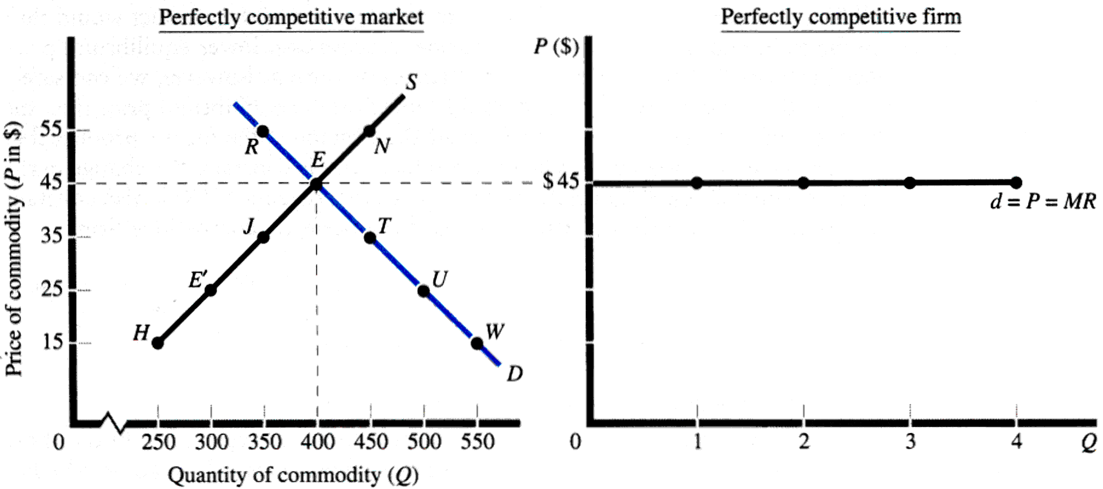
Price Determination
The individual firm takes the market price as given.

Slide 9
Price Determination

Slide 10
Short-run and Long-run
In the short run, one factor of production is fixed, usually the plant size.
Firms cannot enter or leave the industry.
In the long run, all factors are variable.
Firms will enter the industry in response to profits.
Firms will leave the industry in response to losses.

Slide 11
Profit Maximization
Total Profits = TR –TC
At maximum profit, dΠ = 0
dQ
dΠ = d(TR) - d(TC) = 0
dQ dQ dQ
MR - MC = 0
MR = MC
d(TR) = d(PQ) = P = MR
dQ dQ

Slide 12
Short-run equilibrium
Firm’s Demand Curve = Market Price
= Marginal Revenue
Firm’s Supply Curve = Marginal Cost
where Marginal Cost > Average Variable Cost

Slide 13

The MC is the cost of producing additional (marginal) units of output. It falls at first (due to the law of diminishing returns) then rises as output rises.
Diagrammatic representation
Cost/Revenue
MC
The industry price is determined by the demand and supply of the industry as a whole. The firm is a very small supplier within the industry and has no control over price. They will sell each extra unit for the same price. Price therefore = MR and AR
AC
P = MR = AR
Q1
Output/Sales

Slide 14
Now assume a firm makes some form of modification to its product or gains some form of cost advantage (say a new production method). What would happen?
Perfect Competition
Average and Marginal costs could be expected to be lower but price, in the short run, remains the same.
Diagrammatic representation
Cost/Revenue
Because the model assumes perfect knowledge, the firm gains the advantage for only a short time before others copy the idea or are attracted to the industry by the existence of abnormal profit. If new firms enter the industry, supply will increase, price will fall and the firm will be left making normal profit once again.
MC
MC1
The lower AC and MC would imply that the firm is now earning abnormal profit (AR>AC) represented by the grey area.
AC
AC1
P = MR = AR
Abnormal profit
AC1
P1 = MR1 = AR1
Q1
Q2
Output/Sales

Slide 15
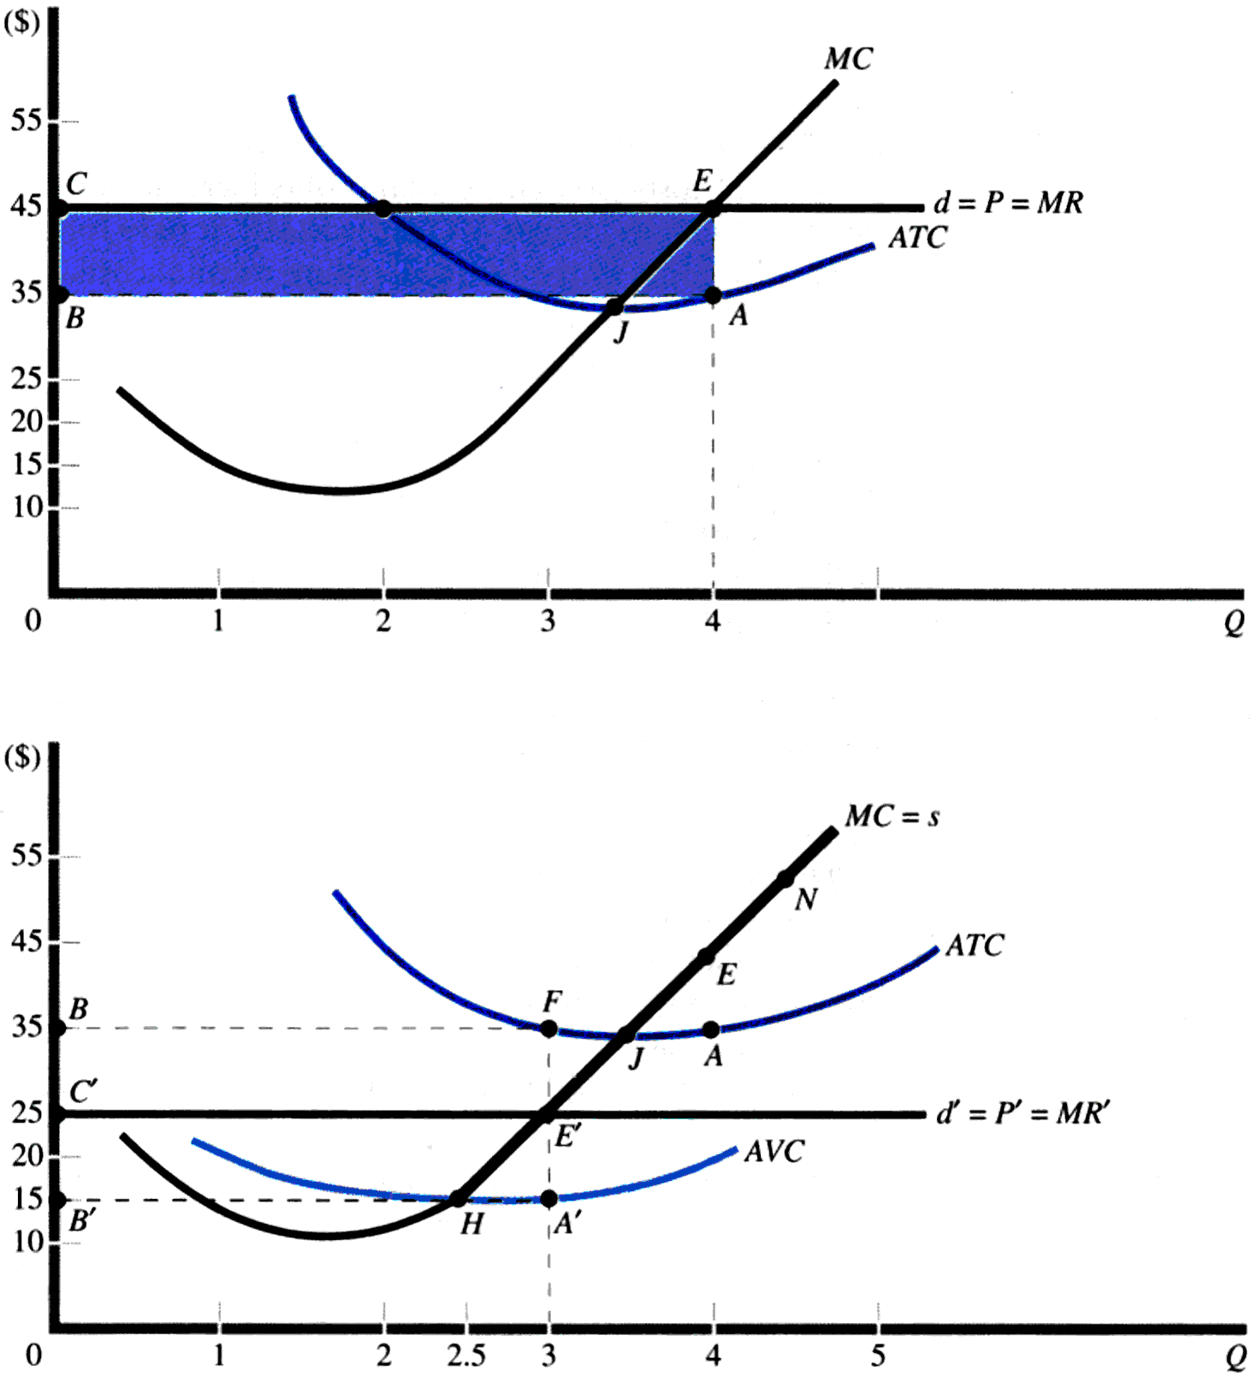
Short-run equilibrium

Slide 16
Suppose the market supply and demand equations for plywood are given by
Qs= 20000+30P
Qd= 40000-20P
Determine equilibrium Price and quantity.
Marginal cost and Average cost of Lucknow Plywood is
MC= 200+4Q
AC= 1000/Q +200+2Q
What is equilibrium Output and Economic profit of Lucknow Plywood ?

Slide 17
Short-run decisions
Competitive firms are price takers, so they can sell all they want at the going market price. As a result, their marginal revenue is equal to product price.
The demand curve facing the competitive firm is a straight line demand at market price.
Competitive firms will maximize profit by producing that output where marginal revenue equals marginal cost (MR = MC).
When price is greater than the minimum point of average total cost, firms earn economic profits.

Slide 18
Short-run decisions
Loss

Slide 19
Losses and Shutdown Decision
If P = 4, what is equilibrium output?
Q = 6
At equilibrium, TR= 4*6 = 24
TC= TVC+TFC= 6*3.50 + 5 = 26
Profit = TR-TC= 24-26= -2
Since there is a loss should the firm shut down? Whether the losses increase or decrease by shut down?

Slide 20
Losses and Shutdown Decision
12
Price, cost
per unit
10
8
MC
6
C
ATC
5
4
AVC
3.35
2
0
0
1
2
3
4
5
6
7
8
9
10
Quantity per period

Slide 21
Losses and Shutdown Decision
Price, cost
per unit
12
10
8
MC
6
C
ATC
5
4
B
AVC
3.35
2
0
0
1
2
3
4
5
6
7
8
9
10
Quantity per period

Slide 22
Losses and Shutdown Decision
Price, cost
per unit
MC
C
ATC
5
B
AVC
3.35
A
Quantity per period

Slide 23
Short-run decisions
When price is just equal to the minimum point of average total cost, firms earn normal profits.
P=AC -------- Normal Profit
When price is below the minimum point of average total cost, but above the minimum point of average variable costs, the firm continues to operate at a loss.
AVC<P<AC ----- Continue to operate
When price falls below the minimum point on the average variable cost curve, the firm will shut down and incur a loss equal to the amount of total fixed costs.
P<AVC ----- Shut down
The short run supply curve of the firm is the marginal cost curve above the minimum point on the average variable cost curve.

Slide 24
Long-run Adjustments
If firms in the industry are earning short run economic profits, new firms can be expected to enter the industry in the long run, or existing firms may increase the scale of their operations.
Losses will lead to the exit of some firms.
Final equilibrium in the long run is the point at which industry price is just tangent to the minimum point on the ATC curve.

Slide 25
Long-run Adjustments
In long run equilibrium, the firm will earn zero economic profit, and the market will produce the maximum possible consumer and producer surplus.
MC
Consumer Surplus
P
P
P=ATC
Producer Surplus
Industry
Firm

Slide 26
Long-run Adjustments
When competitive firms are earning short run economic profits, these profits attract firms into the industry.
Supply increases and market price falls until firms are earning zero economic profits.
Losses mean that some firms will leave the industry. This reduces supply, increasing prices until profits return to normal.
Competitive markets are efficient because P = MR = MC = SRATC_{min} = LRATC_{min}.

Slide 27
Long-run Adjustments
Competitive markets are productively efficient because products are produced at their lowest possible opportunity cost.
Competitive markets are allocatively efficient because P = MC and consumer and producer surplus is at a maximum.

